Slide 1

MODULE 10.3 FINAL PROJECT
ASP.NET PROGRAMMING
Shail Desai

Slide 2
INVENTORY MANAGEMENT SYSTEM
INTRODUCTION
The Inventory Management System is an integrated software platform designed to efficiently manage and track product and supplier inventory in real-time, using a responsive web interface for user operations and a robust API for backend data handling. It leverages the ASP.NET framework and SQL Lite database to facilitate a full spectrum of inventory operations, from stock levels to supplier management.
BENEFITS
The Inventory Management System offers numerous benefits, including streamlined inventory tracking, reduced risk of stockouts or overstocking through accurate demand forecasting, enhanced operational efficiency, and improved decision-making with real-time data analytics. Additionally, it simplifies supplier management, increases productivity through automation, and supports better customer service by ensuring product availability.

Slide 3


Introduction to NorthwindInventoryAPI
Title: NorthwindInventoryAPI: Powering Inventory Management
Central backend service for real-time inventory data management.
Manages and transacts with Northwind.db for product and supplier data.
Crucial component for the system's data integrity and operational flow.
GET
SET
GET
SET
NorthwindInventoryAPI
Northwind Database

Slide 4

API Controllers
Title: Controllers: Gatekeepers of Data
ProductsController & SuppliersController: Main endpoints for inventory operations.
Execute Create, Read, Update, Delete (CRUD) operations asynchronously.
Enhance application responsiveness and manage data efficiently.
C R U D
Create
Read
Update
Delete
SupplierController.cs
ProductsController.cs

Slide 5
Database Interaction via Entity Framework
Title: Efficient Data Handling
NorthwindContext: Facilitates communication between API and SQLite database.
Detailed configuration ensures reliable data connectivity and operations.
Entity Framework provides an effective ORM solution, streamlining database interactions.
Context and Entity Classes
Entity Framework

Slide 6

API Routing and Middleware
Title: API Routing and Middleware Configuration
HTTPS redirection and Swagger UI configured for secure, testable endpoints.
Routing is meticulously designed for easy API navigation and endpoint discovery.
Robust security with authorization checks to protect sensitive data transactions.

Slide 7
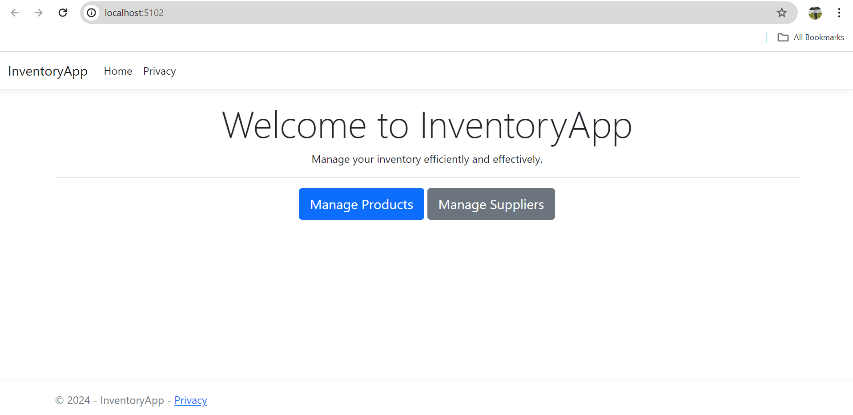
InventoryApp Overview
Title: InventoryApp: Interactive User Interface
Serves as the front-end user interface for inventory management.
HomeController directs users through primary navigation paths.
Interactive elements powered by ProductsController and SuppliersController.

Slide 8
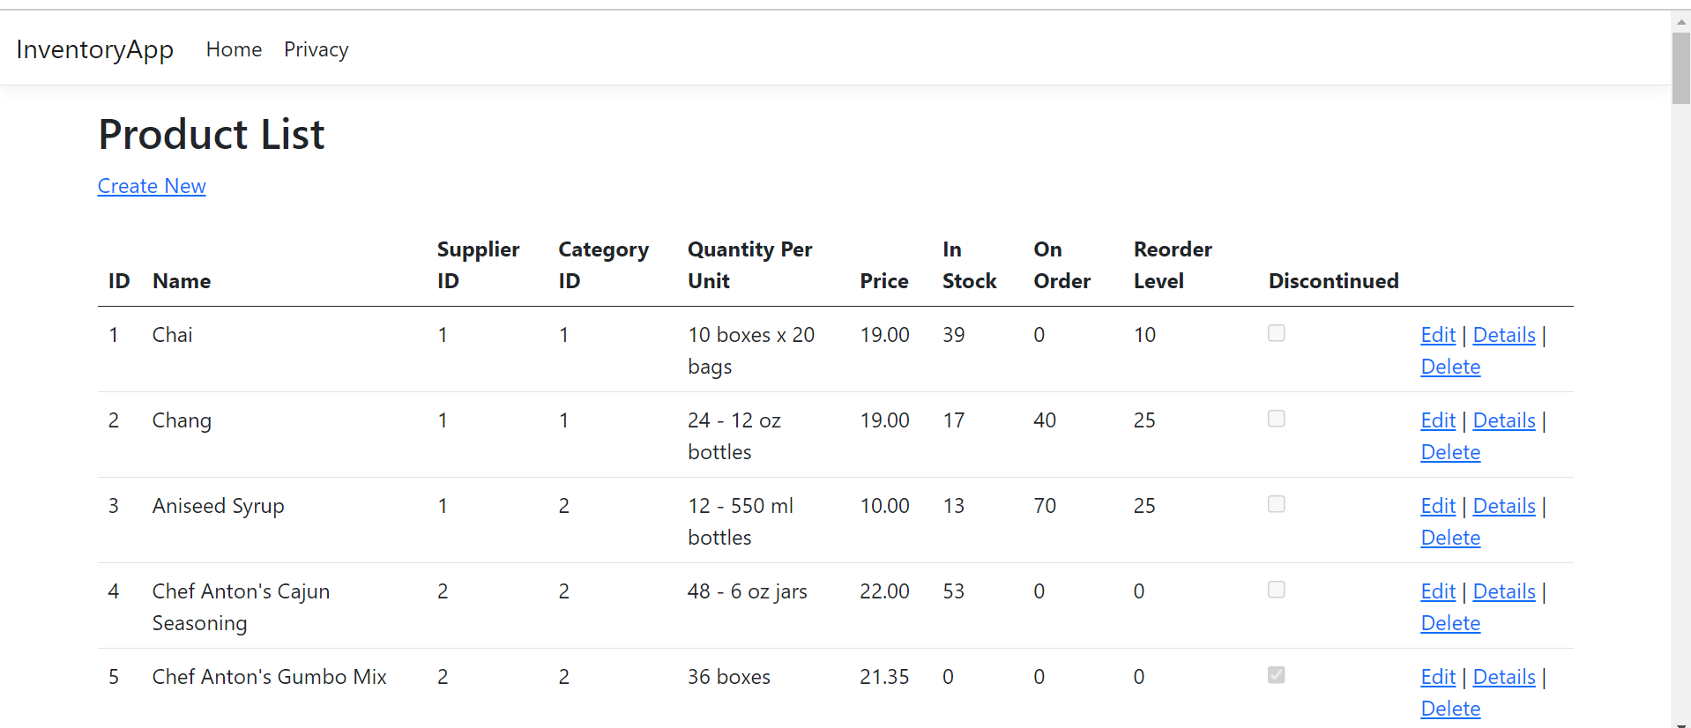
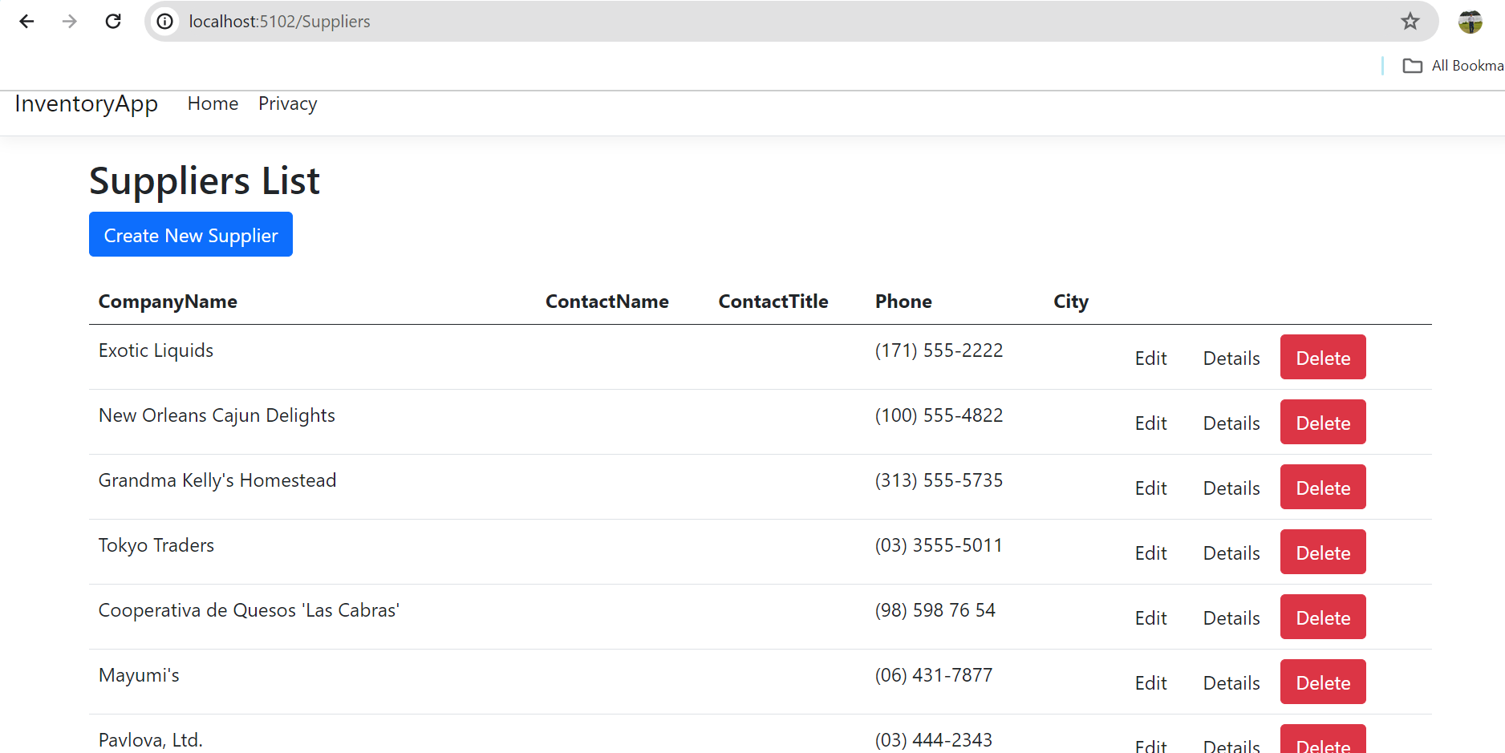
Product and Supplier Management
Title: Managing Products and Suppliers
Comprehensive management features from viewing to editing inventory items.
SuppliersController centralizes supplier-related operations.
Leverages HttpClientFactory for efficient network calls to backend API.
UI Designs

Slide 9


